Slide 1
SWE 4101
Lec – 3
Software Design

Slide 2
If you give me a program that works perfectly but is impossible to change, then it won’t work when the requirements change, and I won’t be able to make it work. Therefore, the program will become useless.
If you give me a program that does not work but is easy to change, then I can make it work, and keep it working as requirements change. Therefore, the program will remain continually useful.

Slide 3
What is Software Design
is a mechanism to transform user requirements into some suitable form, which helps the programmer in software coding and implementation.
It deals with representing the client's requirement, as described in SRS (Software Requirement Specification) document, into a form, i.e., easily implementable using programming language.
moves the concentration from the problem domain to the solution domain.
In software design, we consider the system to be a set of components or modules with clearly defined behaviors & boundaries.

Slide 4
Objectives of SW Design
.
01
06
Maintainability
should be so simple so that it can be easily maintainable by other designers.
Correctness
should be correct as per requirement
05
02
Completeness
should have all components like data structures, modules, and external interfaces, etc.
Consistency
There should not be any inconsistency in the design..
Efficiency
Resources should be used efficiently by the program.
Flexibility
Able to modify on changing needs.
04
03

Slide 5
Why Software Design is Important?
Makes code easier to understand
Easier to fix bugs & add new features
Saves time & money in long run
Helps team work together
Reduces frustration later!

Slide 6
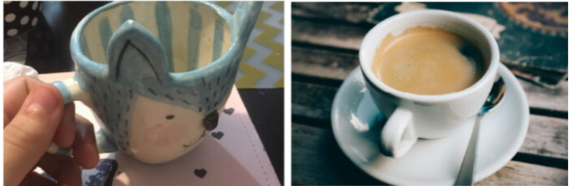

Bad Design vs Good Design
Bad: House with no plan → walls in wrong place, costly fixes
Good: Proper blueprint → everything fits, easy to extend
Software is the same!

Slide 7
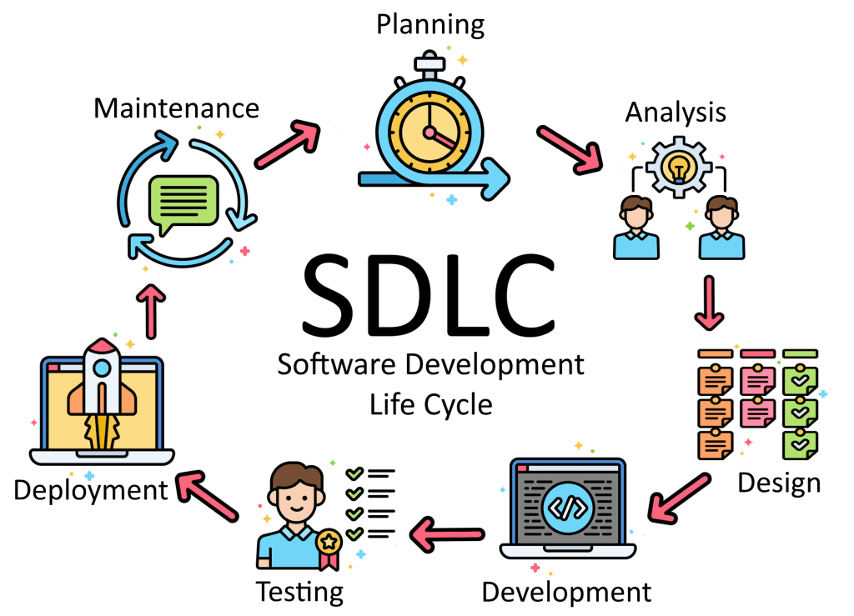
When Do We Do Design?
Design comes early, but we keep improving it

Slide 8
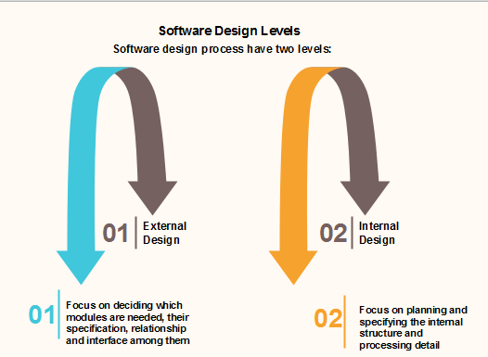
SW Design Level
Detail Level Design
High Level Design

Slide 9
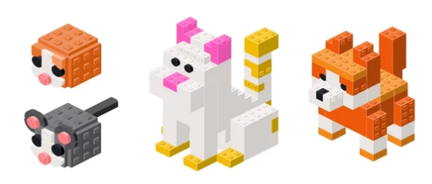
Modularity – The Most Important Idea
Divide big problem → small independent pieces (modules)
Car = engine + wheels + seats
App = login + dashboard + payment

Slide 10
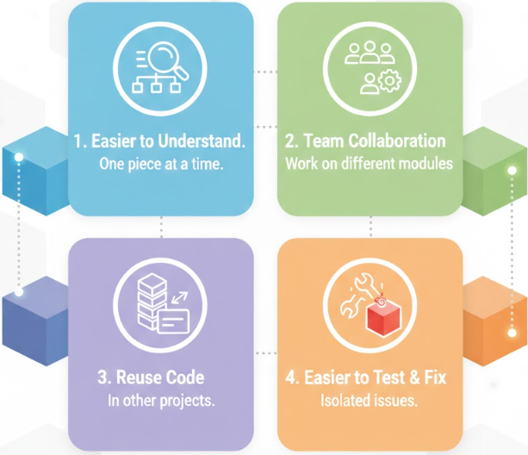
Benefits of Modularity

Slide 11
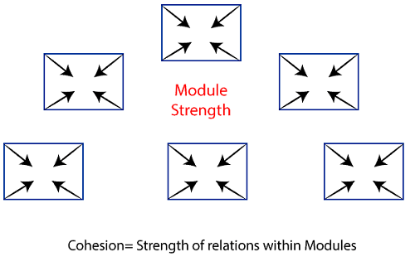
Cohesion – Keep Related Things Together
High Cohesion = good All code in a module does one clear job
Example:
Good → LoginModule (only login, logout, forgot password)
Bad → GodModule (login + payment + chat + game)

Slide 12
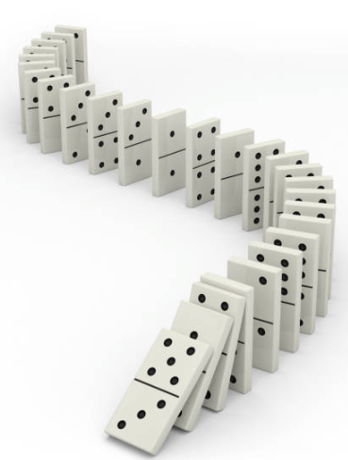
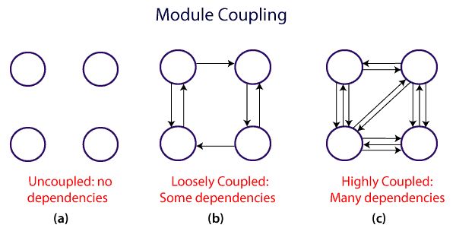
Coupling – How Much Modules Depend on Each Other
Low Coupling = good Modules should be as independent as possible
Like: Changing car color shouldn't break engine
High Coupling is always bad..
Example: Module A changes → Module B breaks → like domino effect

Slide 13

Goal of Good Design
High Cohesion + Low Coupling = Good Design

Slide 14
Software Design Principles
Software design principles are concerned with providing means to handle the complexity of the design process effectively.
Effectively managing the complexity will not only reduce the effort needed for design but can also reduce the scope of introducing errors during design.
The key software design principles are:
SOLID
Pls check next Slide
DRY
Don’t Repeat Yourself
each small pieces of knowledge (code) may only occur exactly once in the entire system.
This helps us to write scalable, maintainable and reusable code.
YAGNI
KISS
You ain't gonna need it
always implement things when you actually need them
never implements things before you need them.
Keep it simple, Stupid!
keep each small piece of software simple
unnecessary complexity should be avoided.

Slide 15
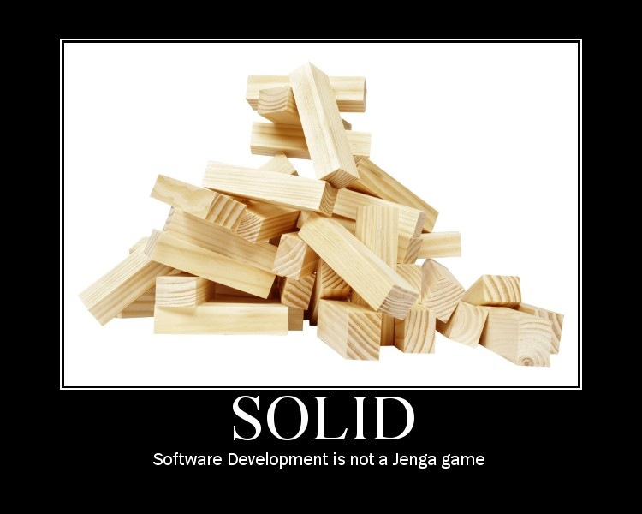

Software Design Principles - SOLID
In Object Oriented Programming (OOP), SOLID is an acronym, introduced by Michael Feathers, for five design principles used to make software design more understandable, flexible, and maintainable.
There are five SOLID principles:
Single Responsibility Principle (SRP)
Open Closed Principle (OCP)
Liskov Substitution Principle (LSP)
Interface Segregation Principle (ISP)
Dependency Inversion Principle (DIP)

Slide 16
OO Concept

Slide 17
Classes and Objects
A class is a template for objects.
A class defines object properties including a valid range of values, and a default value.
A class also describes object behavior.
An object is a member or an "instance" of a class.
An object has a state in which all of its properties have values that you either explicitly define or that are defined by default settings
Objects are generated by the classes and they actually contain values.
We design an application at the class level.

Slide 18




Let's take an example
We want to develop device management system, for example Mobile phone.
how you design such software?
Let’s start with few mobiles
Figure out few differences
These also can be listed as their common characteristics
Figure out few common action that can be performed by these devices

Slide 19
Let's take an example
Common Characteristics
Manufacturer
Dimension
No. of Camera
No. of Sim supported
Price
Common action
Make call
Capture image
Send SMS
Play music

Slide 20
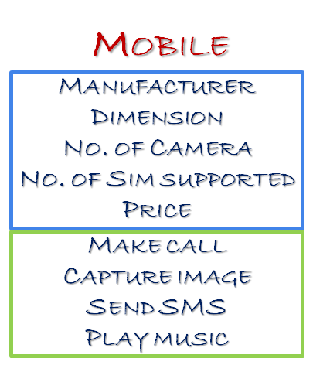
Let's take an example
So far we have defined following things,
Class - Mobile
Attributes – Manufacturer, Dimension, No. of Camera, No. of SIM supported, Price
Methods- Make call ,Capture image, Send SMS, Play music
Class
Attribute
Method

Slide 21
Let's take an example
Now, for different values of attribute (manufacturer, dimension, no. of camera..etc.) in your class, you will get different mobile objects.
Manufacturer = Apple
Dimension = 164.3 x 74.6 x 8.4 mm
No. of Camera = 3
No. of Sim supported =1
Price = $990
Manufacturer = Samsung
Dimension = 164.3 x 74.6 x 8.4 mm
No. of Camera = 3
No. of Sim supported =2
Price = $440
Manufacturer = Xiaomi
Dimension = 164.3 x 74.6 x 8.4 mm
No. of Camera = 3
No. of Sim supported =2
Price = $440
Each class describes a possibly infinite set of individual objects.

Slide 22

Encapsulation (information hiding)
The ability to protect some components of the object from external entities ("private").
Encapsulation is achieved when each object keeps its state private, inside a class.
Protect data from outside misuse
Other objects don’t have direct access to this state. Instead, they can only call a list of public functions — called methods.
Each objects methods manage it’s own attributes.
This is also known as hiding. Like Medicine capsule – content hidden & protected
In code, use private variables, give public methods

Slide 23
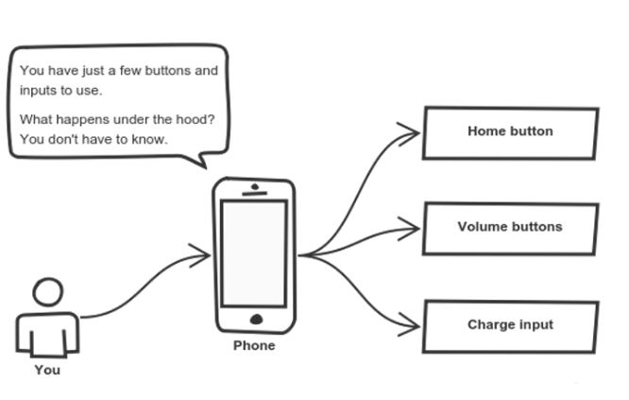
Abstraction
Abstraction can be thought of as a natural extension of encapsulation.
Show only what is needed, hide how it works
Abstraction is a concept aiming to ease this problem.
Applying abstraction means that each object should only expose a high-level mechanism for using it.
Think about your mobile again

Slide 24
Class Hierarchies & Inheritance
Objects are often very similar. They share common logic. But they’re not entirely the same
Every class, except Object, has a superclass
A class may have several ancestors, up to Object
When you define a class, you specify its superclass
If you don’t specify a superclass, Object is assumed
Every class may have one or more subclasses
Inheritance is important since it leads to the reusability of code.
Class hierarchy diagrams
Class: Chair
subclasses
Chair Type A
Chair Type B

Slide 25
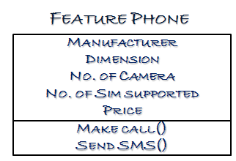
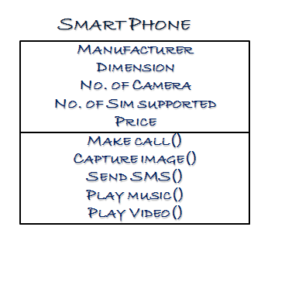
Recall the mobile Phone Example

Slide 26
Class Inheritance & Specialization
Class: Furniture
Attribute A1
Method A1
Class name
Attributes
Methods
Class: Chairs
[Attribute A1]
Attribute B1
[Method A1]
Method B1
Is a specialization of
Or
Inherits from
Class: Executive Chairs
[Attribute A1]
[Attribute B1]
Attribute C1
[Method A1]
Method B1 (B1 code modified)
Method C1

Slide 27
Polymorphism
Inheritance lets users inherit attributes and methods, and polymorphism uses these methods to perform different tasks.
Means that the same method will behave differently when it is applied to the objects of different classes

Slide 28
Let's take an example
Parent Class
Account
Deposit()
Withdraw()
Child Class
Savings
Current
Payroll
Withdraw()
The operation of deposit and withdraw is same for Savings and Current accounts. So the inherited methods from Account class will work. However the withdraw method need to be modified for payroll class.
when the "withdrawn" method for saving account is called a method from parent account class is executed.
But ,when the "Withdraw" method for the payroll account is called withdraw method defined in the privileged class is executed. This is Polymorphism in OOPs.

Slide 29
Refactoring
Improve Design Without Changing Behavior
Clean code regularly Rename, extract method, remove duplication
Analogy: Like cleaning and reorganizing your house without changing its foundation or adding new rooms. You make it more pleasant and efficient to live in.
Key Principles of Refactoring:
Small Steps: Refactor in small, incremental changes.
Tests First: Always have automated tests in place before refactoring to ensure behavior doesn't change.
Continuous Process: Not a one-time event, but an ongoing practice throughout a project's lifecycle.

Slide 30
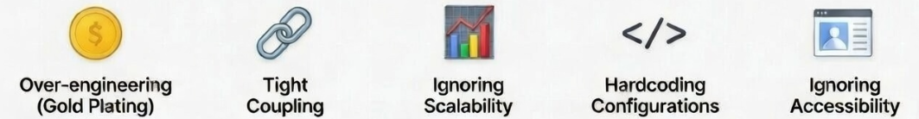
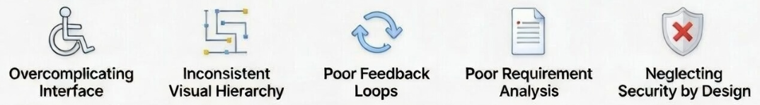
Common Design Mistakes
Adding unnecessary features that exceed requirements
Modules are too dependent on each other
Poor handling of increased load
Static settings, no flexiblity
Poor support for disabled users
Complex UI with unnecessary elements
Unclear information priority
Lack of user progress indicators
Incomplete or unclear spec
No built-in security measures

Slide 31
Design Review
Ask These Questions
Is it easy to understand?
Easy to change one part?
High cohesion & low coupling?
Follows KISS & DRY?

